Slide 1
Algorithms for the Longest Common Subsequence Problem
DANIEL S. HIRSCHBERG
Journal of the Association for Computing Machinery 1977
Presented by Jian-Fu Dong

Slide 2
Abstract
Two algorithms are presented that solve the longest common subsequence problem. The first algorithm is applicable in the general case and requires O(pn + n log n) time where p is the length of the longest common subsequence. The second algorithm requires time bounded by O(p(m + 1 - p)log n) In the common special case where p is close to m, this algorithm takes much less time than n²

Slide 3
The DP Matrix of LCS
 |  |  | 1 | 2 | 3 | 4 | 5 | 6 | 7 | 8
 |  |  | C | A | C | A | G | T | A | G
 |  | 0 | 0 | 0 | 0 | 0 | 0 | 0 | 0 | 0
1 | A | 0 | 0 | 1 | 1 | 1 | 1 | 1 | 1 | 1
2 | G | 0 | 0 | 1 | 1 | 1 | 2 | 2 | 2 | 2
3 | C | 0 | 1 | 1 | 2 | 2 | 2 | 2 | 2 | 2
4 | T | 0 | 1 | 1 | 2 | 2 | 2 | 3 | 3 | 3
5 | G | 0 | 1 | 1 | 2 | 2 | 3 | 3 | 3 | 4
6 | A | 0 | 1 | 2 | 2 | 3 | 3 | 3 | 4 | 4
7 | C | 0 | 1 | 2 | 3 | 3 | 3 | 3 | 4 | 4
8 | G | 0 | 1 | 2 | 3 | 3 | 4 | 4 | 4 | 5

Slide 4
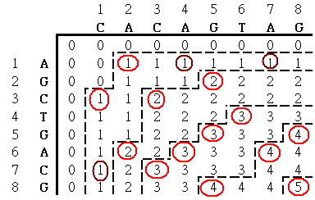
Contours in the scoring matrix

Slide 5
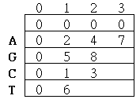

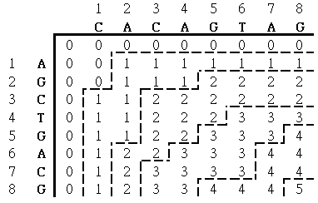
Steps of Hirschberg’s Algorithm(1/8)
k=1,i=1,low=0, high=9,lowcheck=0

Slide 6

Steps of Hirschberg’s Algorithm(2/8)
k=1,i=2,low=0, high=2,lowcheck=1

Slide 7

Steps of Hirschberg’s Algorithm(3/8)
k=1,i=3,low=0, high=2,lowcheck=1

Slide 8

Steps of Hirschberg’s Algorithm(4/8)
k=1,i=8,low=0, high=1,lowcheck=1

Slide 9
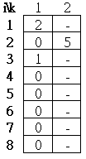
Steps of Hirschberg’s Algorithm(5/8)
k=2,i=2,low=2, high=9,lowcheck=1

Slide 10
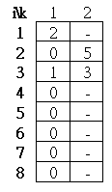
Steps of Hirschberg’s Algorithm(6/8)
k=2,i=3,low=2, high=5,lowcheck=2

Slide 11
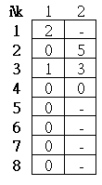
Steps of Hirschberg’s Algorithm(7/8)
k=2,i=4,low=1, high=3,lowcheck=2

Slide 12
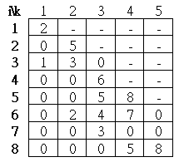
Steps of Hirschberg’s Algorithm(8/8)

Slide 13
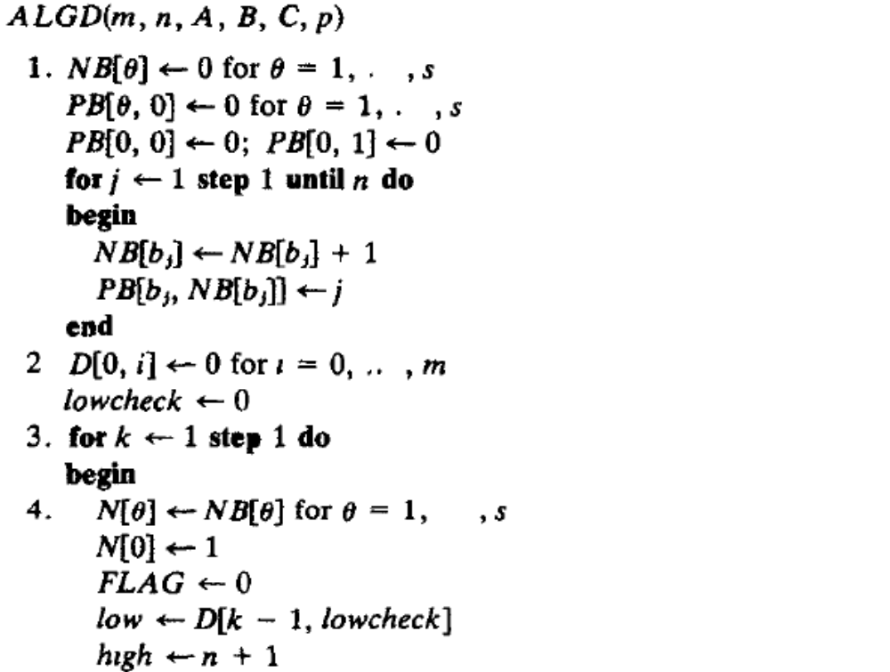
Hirschberg’s Algorithm(1/2)

Slide 14
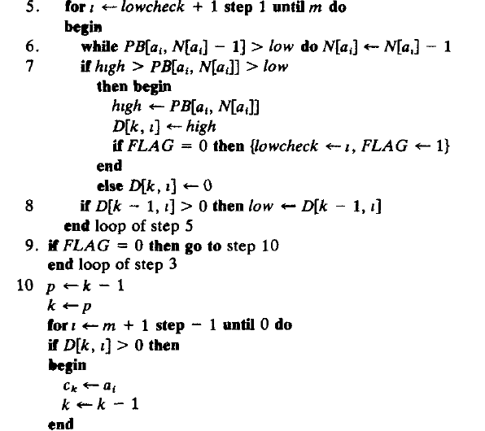
Hirschberg’s Algorithm(2/2)

Slide 15
Time Complextiy
Step 1: O( n log s )
Step 2 : O( m )
Step 3 : O( p )
Step 4 : O( ps )
Step 5 : O( pn )
Step 6 : O( pn )
Step 7,8 : O(pm)
Step 9 : O( p )
Step 10 : O(m)
Therefore T(n)= O( pn )

Slide 16
Hirschberg’s Algorithm II
Assume that there is an LCS length at least m-ε for some given ε. If C is an LCS of A and B, there will be at most ε elements of A that do not appear in C.
The position of each such element will be called a “skipped position”.
A : CGCATTATTG
B : AACTATGAT

Slide 17
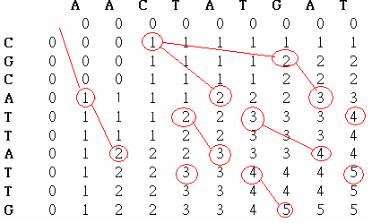

Result of ALGE

Slide 18

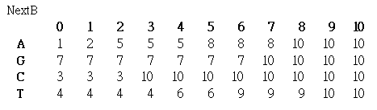
Initial Step of ALGE
Assume ε=6

Slide 19
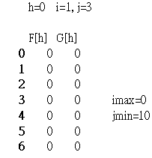
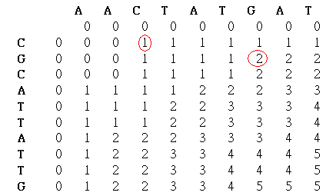
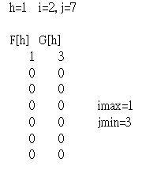
Steps of ALGE

Slide 20
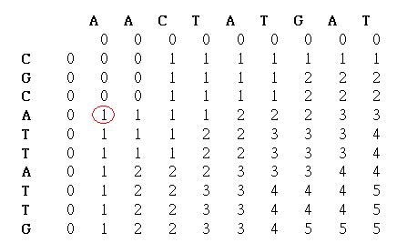
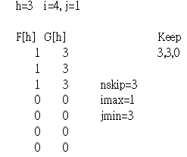
Steps of ALGE

Slide 21
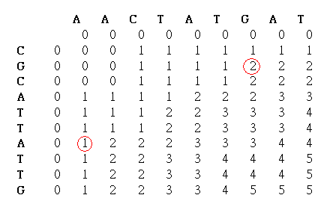
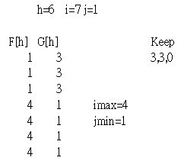
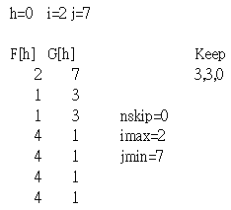
Steps of ALGE

Slide 22
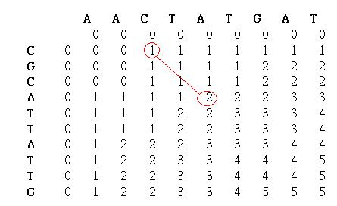
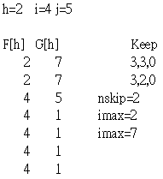
Steps of ALGE

Slide 23
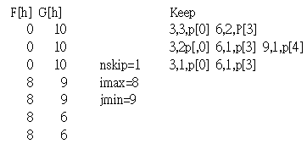
Final Result of ALGE

Slide 24
Time Complexity
pe(log n) where e= ε+ 1
∵e <2(m+1-p) ∴T(n)=O(p(m+1-p)log n )

